Slide 1
Cognitive tasks & Questionnaires
Summer School UNSW 2020: Research Lab 3
Jennifer Sloane
Tehilla Mechera-Ostrovsky

Slide 2

Goals
Have a solid understanding of each cognitive tasks used in our experiment
Cognitive Reflection Test
Flanker Task
Random Dot Motion Paradigm
Have a solid understanding of the surveys
Impulsivity
Self-Control
Big 5
Understand the concept of reverse coding

Slide 3
Cognitive reflection test

Slide 4
Cognitive Reflection test
What is the CRT (include one example)?
What is System 1 and System 2 processing?
What is it about the CRT questions that make them tricky?
Describe details of the experiment:
How many participants?
Who were the participants?
Were they incentivized in any way?
How long was the study?
What was the study?

Slide 5
Cognitive Reflection test
What were the other IQ measures?
Are the IQ measures correlated? If so, how?
In the IQ section of the paper, how does the author define what the CRT measures?
What makes the CRT so attractive as an IQ test
Are there any sex differences?

Slide 6
Cognitive Reflection test
What is the CRT (include one example)? A 3 item “Cognitive Reflection Test” that measures one type of cognitive ability
What is System 1 and System 2 processing?
System 1 = automatic processing that occurs spontaneously and effortlessly
System 2 = mental operations that require effort, motivation, and concentration
What is it about the CRT questions that make them tricky? In order to reach the correct answer, you have to inhibit an erroneous, impulsive answer that typically comes to mind first
Describe details of the experiment:
How many participants? 3,428
Who were the participants? Most were undergrads from several universities in the States
Were they incentivized in any way? $8
How long was the study? 45 minutes
What was the study? CRT and measures of other decision making characteristics like time and risk preference

Slide 7
Cognitive Reflection test
What were the other IQ measures? Wonderlic Personnel Test (WPT), Need for cognition scale (NFC), SAT, and ACT
Are the IQ measures correlated? If so, how? Positively correlated
In the IQ section of the paper, how does the author define what the CRT measures? “the ability or disposition to resist reporting the response that first comes to mind”
What makes the CRT so attractive as an IQ test? Only 3 items that can be administered in a matter of minutes
Are there any sex differences? Yes, men scored significantly higher than women suggesting they reflect more on their answers and less likely to go with the intuitive answer

Slide 8
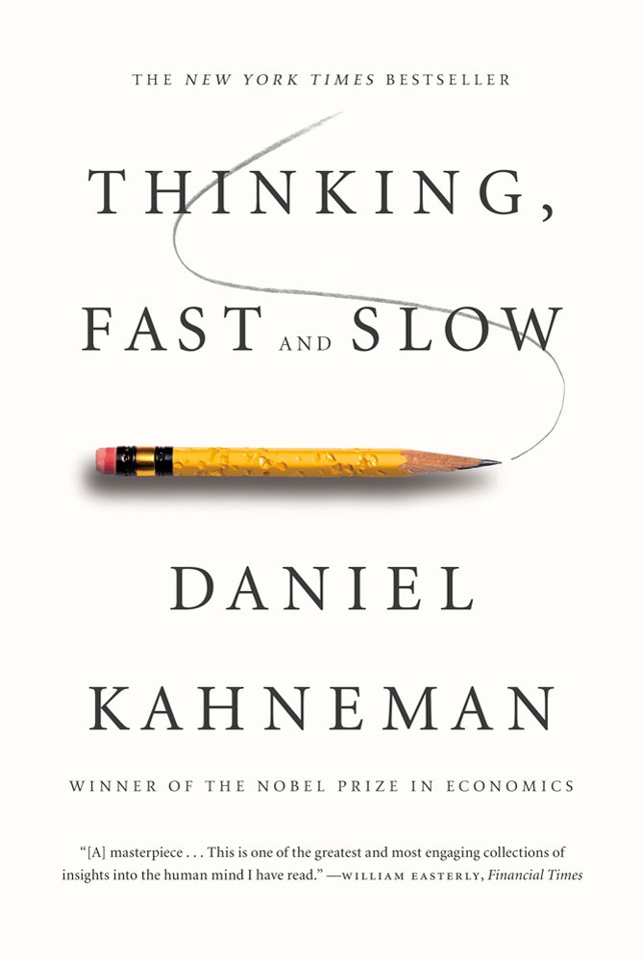
Cognitive Reflection test Discussion
Three-item psychological measure which claims to test individuals on intuitive (System 1) vs. analytic (System 2) cognitive processing
A bat and a ball cost $1.10 in total. The bat costs $1.00 more than the ball. How much does the ball cost? _____ cents
(2) If it takes 5 machines 5 minutes to make 5 widgets, how long would it take 100 machines to make 100 widgets? _____ minutes
(3) In a lake, there is a patch of lily pads. Every day, the patch doubles in size. If it takes 48 days for the patch to cover the entire lake, how long would it take for the patch to cover half of the lake? _____ days
5 cents (not 10)
5 minutes (not 100)
47 days (not 24)
(Frederick, 2005)

Slide 9
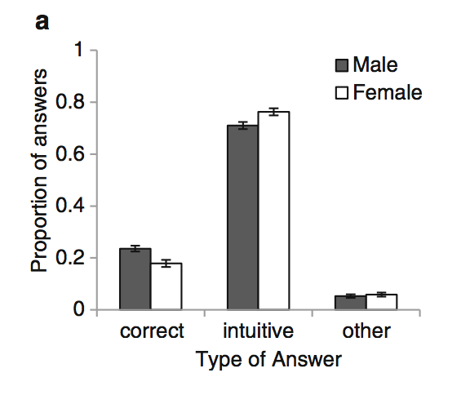
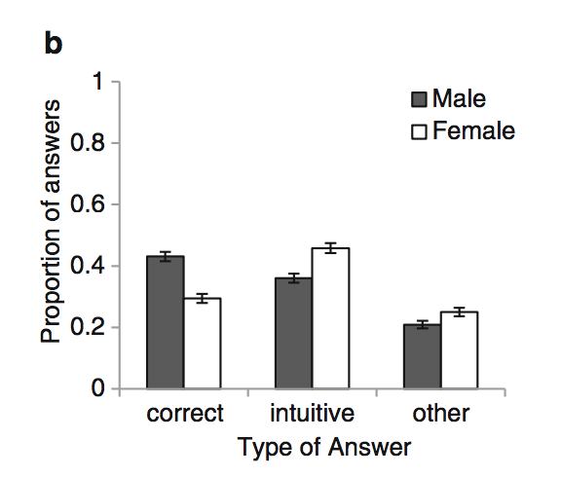
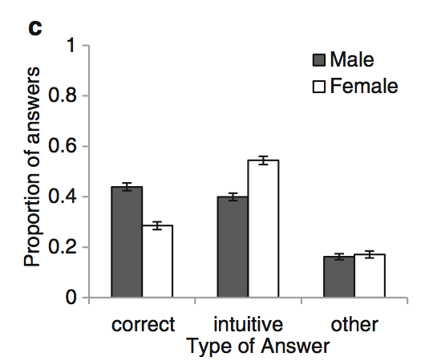

Cognitive Reflection test Discussion
Three-item psychological measure which claims to test individuals on intuitive (System 1) vs. analytic (System 2) cognitive processing
(Campitelli,& Gerrans, 2014)

Slide 10
Cognitive Reflection test Discussion
Three-item psychological measure which claims to test individuals on intuitive (System 1) vs. analytic (System 2) cognitive processing
.44 correlation between CRT performance and SAT scores (Frederick, 2005)
.40 correlation between CRT and cognitive ability (WASI Comp + WM)
Very popular because the questions lead the decision-maker to an incorrect, yet intuitive response that must be inhibited in order to arrive at the correct response
Guess how many times Frederick (2005) has been cited?
Google scholar: Cognitive reflection and decision-making… 4453!!!
Notes:
WASI – some intelligence scale

Slide 11
Flanker task

Slide 12
Flanker task
Atmaca, Sebanz, Knoblich (2011)
What is “social facilitation”?
Are people faster/slower and more/less accurate when they see someone else performing the same action?
What about if someone else is performing the opposite action?
What is “task co-representation” and “shared task representation”?
What is S-R?
What is SNARC?
What is a neutral trial on the flanker task?

Slide 13
Flanker task
Atmaca, Sebanz, Knoblich (2011)
Order from fastest RT to slowest (prediction): Neutral, compatible, incompatible, identical
What is an individual condition vs. joint condition?
What did the authors predict?
Briefly describe Experiment 1.
How many participants?
What did the stimulus look like?
What were targets?
What were response keys?
There are several results listed, pick one and explain what they found

Slide 14
Flanker task
Atmaca, Sebanz, Knoblich (2011)
What is “social facilitation”? A phenomenon that people perform simple tasks more quickly in the mere presence of others
Are people faster/slower and more/less accurate when they see someone else performing the same action? faster and more accurate
What about if someone else is performing the opposite action? Slower and less accurate
What is “task co-representation” and “shared task representation”? The idea that one person is responsible for his/her part as well as the co-actor’s
What is S-R? stimulus-response
What is SNARC? Spatial-numerical association of response codes. People respond faster to small numbers (0-4) on the left side of space and faster to large numbers (6-9) on the right side
What is a neutral trial on the flanker task? When the flanked letters are an arbitrary letter and not one of the possible response buttons

Slide 15
Flanker task
Atmaca, Sebanz, Knoblich (2011)
Order from fastest RT to slowest (prediction): Neutral, compatible, incompatible, identical
Identical, compatible, neutral, incompatible
What is an individual condition vs. joint condition? Individual – completes a go/no-go task on their own. Joint – next to a co-actor
What did the authors predict? Larger difference between RTs on incompatible trials and all other trails in the joint condition compared to individual condition
Briefly describe Experiment 1. Flanker task with letters. Joint condition – two people did the task where each responded to 2/4 targets by pressing a single response key (individual – just on their own)
How many participants? 48 students
What did the stimulus look like? Array of 5 letters with the target letter in the middle
What were targets? H K S C
What were response keys? One key = H and K. other key = S and C
There are several results listed, pick one and explain what they found

Slide 16
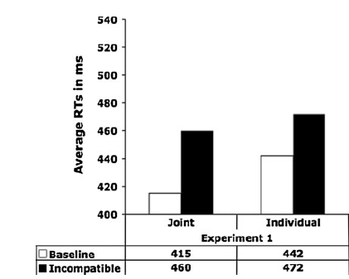
Flanker task Discussion
Incompatible trials, on average, took longer
There appears to be a larger difference in RTs between baseline and incompatible in the joint condition
Faster RTs for baseline in the joint condition compared to the individual condition

Slide 17
Flanker task Discussion
Stroop Task:
Say the color of the word out loud as quickly as possible

Slide 18
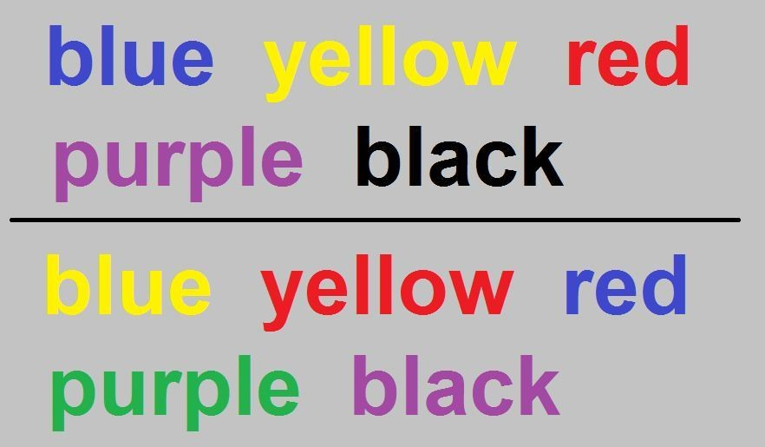

Slide 20
Flanker task Discussion
How are the Stroop and Flanker Tasks similar?

Slide 21
Random dot motion paradigm

Slide 22
Random dot motion paradigm
Mulder et al. (2013)
What is the RDM task?
Describe 2 ways you could make the RDM more challenging?
What is the speed-accuracy tradeoff (you can google it)?
What is RTP?
Explain the difference between RDM and RTP?
What did participants have to do in this study?
Who were the participants?

Slide 23
Random dot motion paradigm
Mulder et al. (2013)
What manipulation was used to make the RTP more challenging?
In the RTP task, what happened if the participant responded too slowly?
To understand the results, look at Figure 3. As best as you can, explain what you see.
Are you surprised by these findings? Why or why not

Slide 24
Random dot motion paradigm
Mulder et al. (2013)
What is the RDM task? Task where participants have to decide as quickly and accurately as possible if a cloud of dots are moving to the right or left
Describe 2 ways you could make the RDM more challenging? Changing the number of coherently moving dots (less dots the harder it will be). Making participants respond faster
What is the speed-accuracy tradeoff (you can google it)? Speed – go faster but make more errors. Accuracy – go slower but less errors
What is RTP? Random-tone pitch – the task the authors designed
Explain the difference between RDM and RTP? RDM – visual dots. RTP – auditory sounds
What did participants have to do in this study? Decide if a mixture of randomly changing tones moved up or down a pitch scale
Who were the participants? The 4 authors

Slide 25
Random dot motion paradigm
Mulder et al. (2013)
What manipulation was used to make the RTP more challenging? Changed the number of coherently changing tones on a pitch scale (0% 5% 10% 20% and 80%)
In the RTP task, what happened if the participant responded too slowly? Saw “too slow” and heard a buzz sound
To understand the results, look at Figure 3. As best as you can, explain what you see. Every participant’s data for both the RDM and RTP is illustrated. The pattern of data looks similar for auditory and visual. Speed accuracy tradeoff worked – accuracy lines higher for proportion correct and RT (slower and better performance)
Are you surprised by these findings? Why or why not? I’m not because the speed accuracy manipulation is usually pretty reliable and they attempted to create an auditory version of the RDM, so the results should be similar to results of the RDM

Slide 26
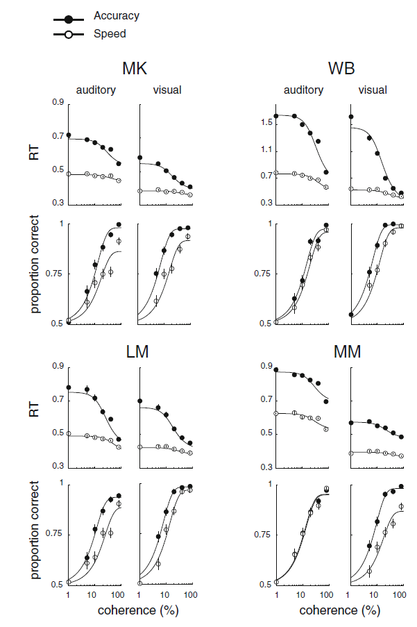
Random dot motion paradigm Discussion
MK, WB, LM, MM – the 4 authors/4 participants
What are advantages/disadvantages to having hundreds of participants vs. 4?
With the accuracy manipulation: participants respond slower, but are more accurate
With the the speed manipulation: participants respond faster, but are less accurate
The pattern of data looks similar for auditory and visual

Slide 27
Questionnaires

Slide 28
Questionnaires
Barratt impulsiveness scale (bis) – 30 items
*I plan tasks carefully
I do things without thinking
*I make-up my mind quickly
*I plan trips well ahead of time
Self Control Scale – 13 items
I am good at resisting temptation
*I have a hard time breaking bad habits
I refuse things that are bad for me
*I have trouble concentrating
Big 5 (short) – 15 items
Worries a lot (N)
*Is reserved (E)
Has an active imagination (O)
Has a forgiving nature (A)
Scale: Rare/Never, Occasionally, Often, Almost Always/Always
Scale:
1: Not at all, 2, 3, 4, 5: Very Much
Scale: Disagree strongly, Disagree a little, Neither, Agree a little, Agree strongly

